Slide 1

2020 CUAHSI Officers
Jerad D. Bales, President & Executive Director
Steven Loheide (University of Wisconsin), Chair of the Board of Directors
Audrey Sawyer (Ohio State University), Treasurer
Adam Ward (Indiana University), Secretary
Consortium of Universities for the Advancement of Hydrologic Science, Inc.

Slide 2






CUAHSI (coo-AH-see)
CUAHSI’s mission is to shape the future of water science by:
Strengthening interdisciplinary collaboration in the water science community,
To empower the community by providing critical infrastructure, and
To promote education in the water sciences at all level
Key support comes from:
Notes:
More than 130 academic institutions and affiliate members
Key support comes from:
Department of Homeland Security
Johnson Family Foundation
National Aeronautics and Space Administration
National Oceanic and Atmospheric Administration
National Science Foundation

Slide 3
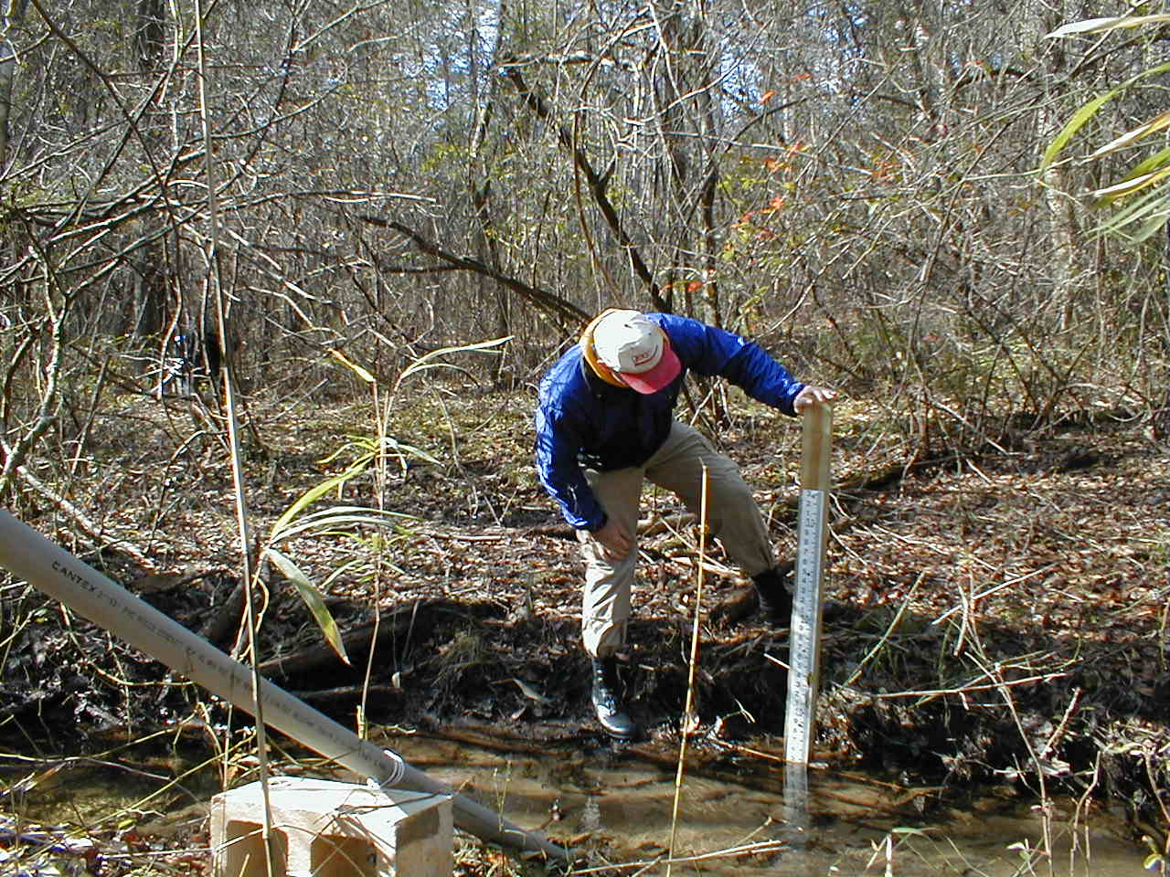
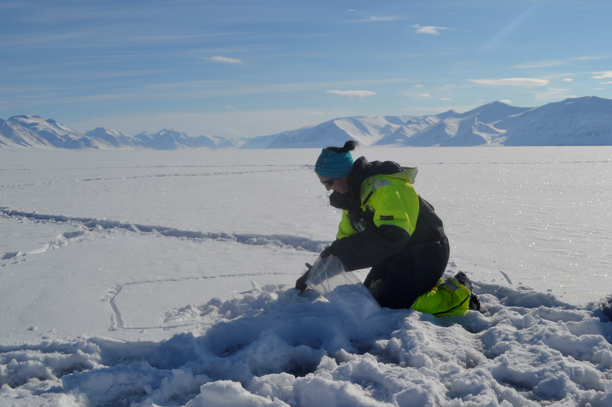
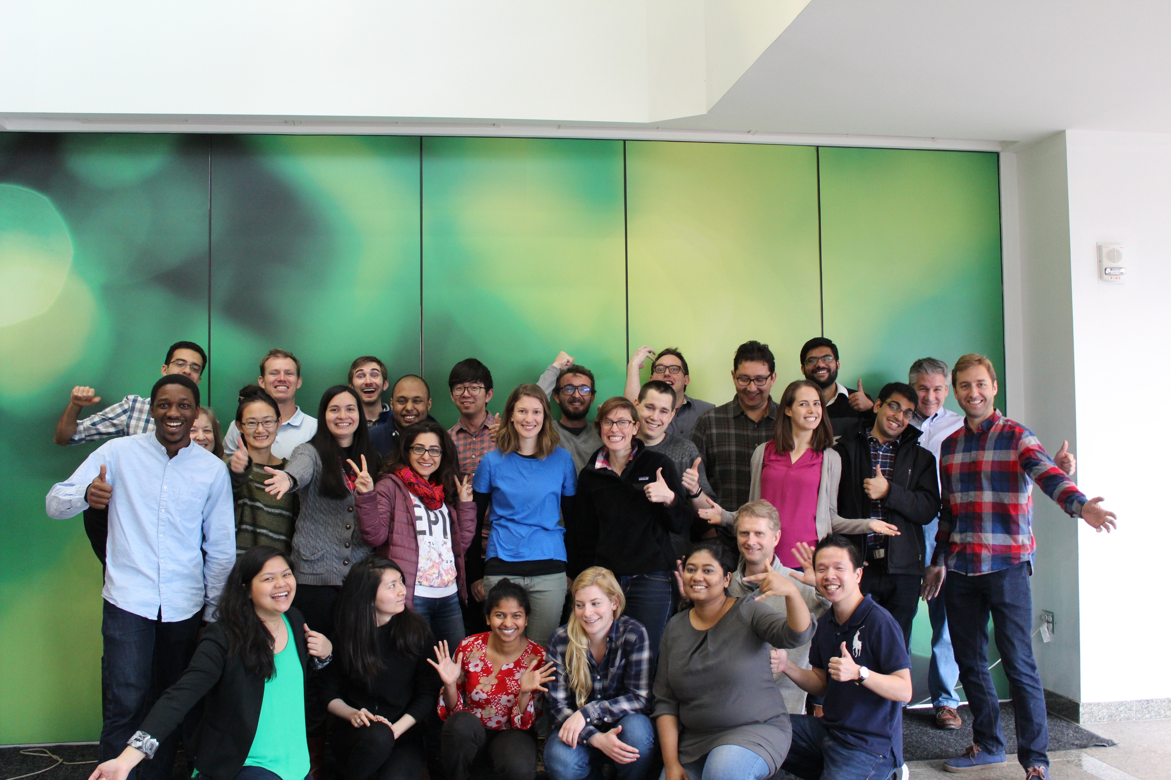
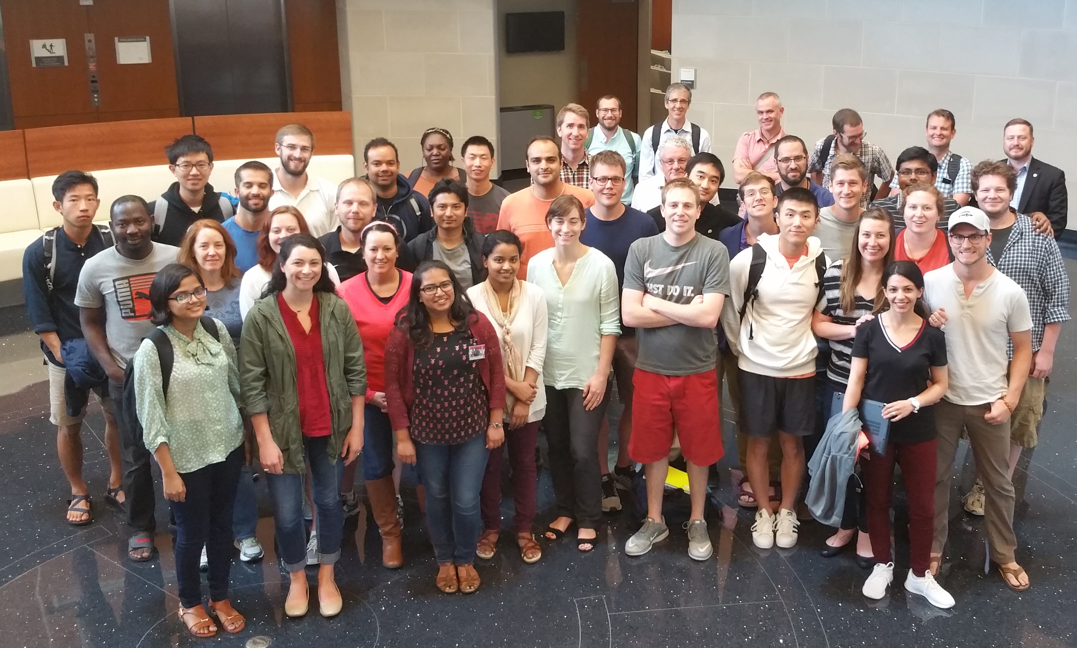
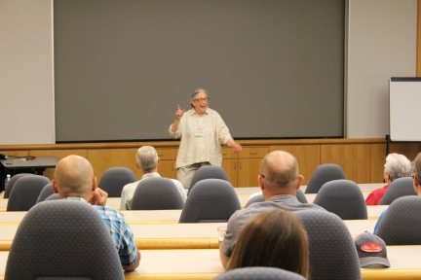
Community Services
CUAHSI provides access to resources and specialized training to build capacity and extend and share current research through:
Providing travel funding for graduate students and early career scientists, and a number of fellowship programs
Hosting training workshops, short courses and a Summer Institute
Organizing online “Cyberseminar” Lectures
Facilitating a Virtual University

Slide 4
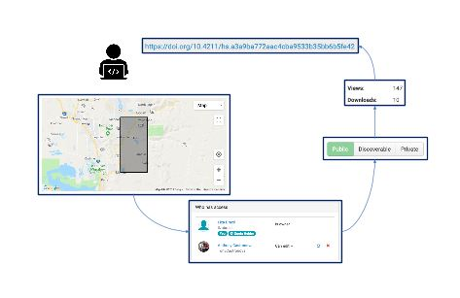
Water Data Services
CUAHSI provides access to data and models to facilitate research and education.
Collaborate around hydrologic data in HydroShare
Find and publish monitoring data with the Hydrologic Information System (HIS)
Develop and execute code using CUAHSI’s JupyterHub
Free, open-source software
Fulfill data management plans
Use for research or classroom
Develop new software

Slide 5
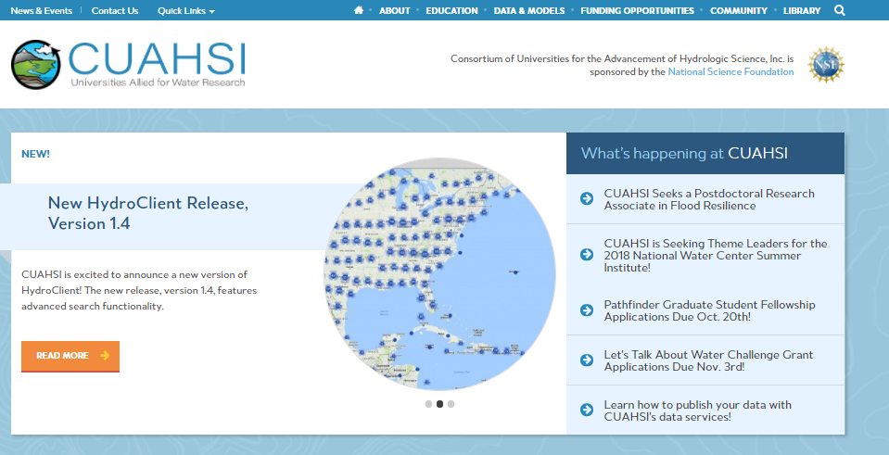
Other CUAHSI Resources
Community Science Meetings
Job Board
List of Graduate Programs
Community News & Events

Slide 7
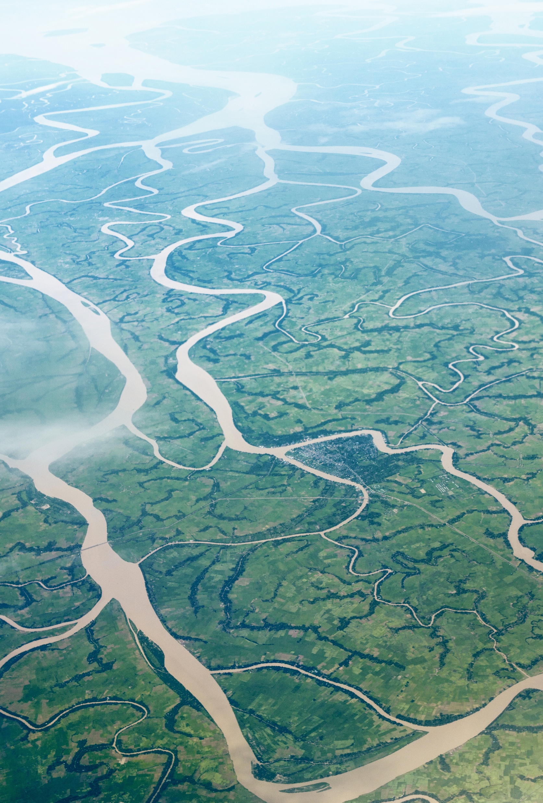
Apply to win a complimentary registration for the AGU 2020 Fall Meeting!
CUAHSI and the Hydrology Section of the AGU are pleased to announce the availability of 200 complimentary Fall Meeting 2020 Student Registration waivers for CUAHSI community and/or Hydrology Section students.
Applications will be accepted beginning Thursday, August 27 at 09:00 Eastern Daylight Time and closed when we have received 800 applications.
cuahsi.org/community/news-events/apply-to-win-a-complementary-registration-for-the-agu-2020-fall-meeting

Slide 8

Lets Talk About Water!
Let's Talk About Water (LTAW) promotes water and earth science education by using film and panel discussions to engage audiences and encourage critical thinking.
Due to the continuing impact of the COVID-19 pandemic on our communities, CUAHSI has implemented a new two-track Let's Talk About Water (LTAW) Competition for 2020.
Track 1: Film Competition & Festival
Track 2: Virtual Let's Talk About Water Event or Series
Proposal Deadline: October 23, 2020

Slide 9
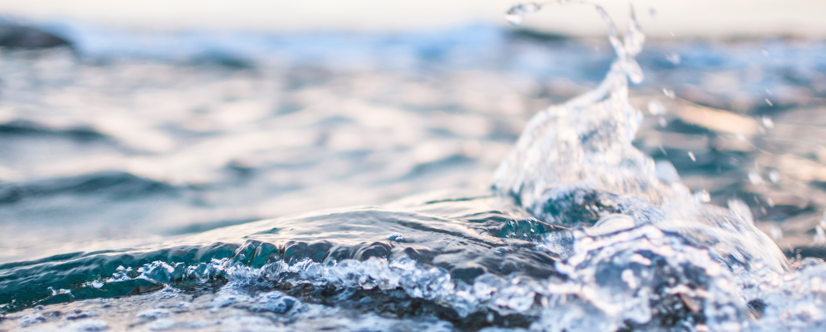
Julia Masterman
CUAHSI Science, Education, and Outreach Coordinator
jmasterman@cuahsi.org
Thank You!

